Slide 1

PGDiploma Multi-Modality Practitioner
Encouraging Healthy Behaviours Through Behaviour Change Presentation Assessment
Presented by: Candice Evans Davies
Student number: @00609818

Slide 2
Section 1:
Assess the client’s current behaviours, and select and specify a target behaviour

Slide 3


Introduction and Aims
Who am I?
This Module
This Presentation

Slide 4





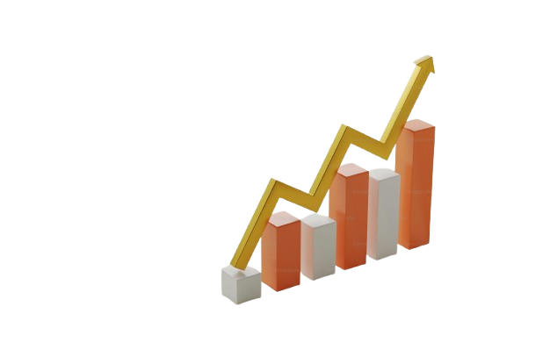
Who is Dan Williams?
1
Demographics
2
Home life
3
Work life
4
General health

Slide 5



Some Additional Risk Factors
BLOOD PRESSURE: NORMAL (SBP AND DBP BELOW 140/90)
Cholesterol: Normal (less than 5.18)
Results:
BMI: 31.2 (OBESITY CLASS 1)
GLYCATED HAEMOGLOBIN: PREDIABETES (5.7 TO 6.4%)
BLOOD GLUCOSE: PREDIABETES (BETWEEN 5.6 AND 6.9)
CARDIORESPIRATORY FITNESS:
POOR TO FAIR (BETWEEN THE 35TH AND 40TH PERCENTILE)

Slide 6

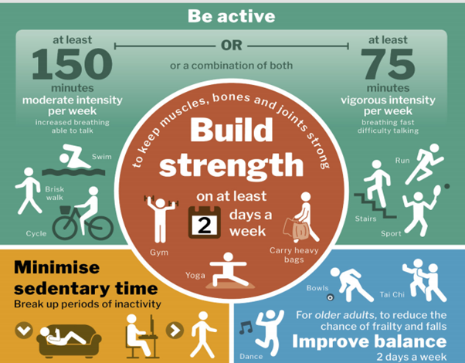
A Closer Physical Activity
“Physical activity is defined as any bodily movement produced by skeletal muscles that results in energy expenditure.”
(Dugdill, Crone, & Murphy, 2009)
CURRENT GOVERNMENT GUIDELINES
For good physical and mental health, adults gov guide recommends adults be active every day This daily activity doesn't have to be intense or long—even light activity like walking, gardening, or taking the stairs counts.

Slide 7

Dan’s Physical Activity
Additional Point
 | Amount They Do | Government Recommendations
Moderate- Vigorous Aerobic Physical Activity (MVPA) | 39 Minutes of Moderate Exercise and 10 Minutes of Vigorous | 150 Minutes of Moderate or 75 Minute of Vigorous
Strength-Based Activities (involving all major muscle groups) | 2 Sessions Per Week | 2 Sessions Per Week
"English physical activity guidance now recognises a double weighting of vigorous over moderate activity; 1 min of vigorous activity is the same as two 'equivalent' minutes of moderate activity." (Roberts et al,2016).
Using this calculation Dan’s total could be viewed as 59 minutes of moderate exercise a week. However, this would still see him short by at least 91 minutes of moderate-intensity activity per week.

Slide 8
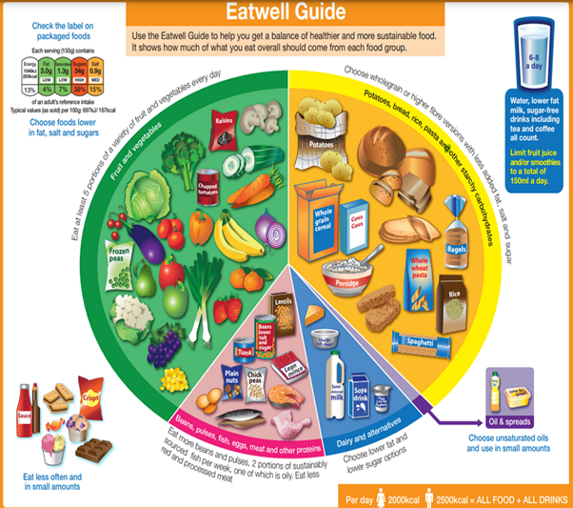
A Closer Look Diet Govt Guideline
GOVERNMENT GUIDELINES
Carbohydrates: should make up around 50% of your dietary intake.
Protein: should make up around 15% of your dietary intake
Fat: should make up maximum 35% of your dietary intake
Saturated Fat: should make up max 11% of your dietary intake
Sugar: should make up max 11% of your dietary intake
Fiber: adults should get 30g or more per day
Fruit & Vegetables: at least 5 portions per day (1 portion equals 80g)

Slide 9

A Closer Look At Dan’s Diet
 | Dans Current Total Intake (grams/ calories/ portions) | Dans Recommended Intake (grams/ calories/ portions) | Comment
Calories | Approx 2700 | Approx 2500 | Over
Protein | 126g | 105g | Slightly Over
Carbohydrates | 350g | 350g | On Target
Fats | 100g | ≤109g | On Target
Saturated fat | 25g | ≤34g | On Target
Salt | 4g | ≤6g | On Target
Sugar | 21g | ≤35g | On Target
Fibre | 27g | ≥30g | Below
Fruit and veg | 7 | ≥ 5 portions | Slightly Over

Slide 10
Potential Impact of Change
Increasing MVPA
Will improve Cardiorespiratory Fitness (CRF): A 2014 meta-analysis on Fitness vs Fatness showed poor CRF to be a greater risk to all-cause mortality than weight and prediabeties. (Barry et al, 2014).
With one 2018 study stating that changes in CRF significantly impacted all-cause mortality risk and suggested that improving fitness levels may be more beneficial for reducing mortality risk than focusing solely on weight loss. (Barry et al 2018).
Additionally, this would reduce his sedentary time, which is important because higher sedentary time is associated with a significantly increased risk of all-cause mortality in people with prediabetes and diabetes, and Replacing the same amount with moderate-to-vigorous physical activity reduced mortality risk by 40%. (Zhu et al 2023).
Increasing Fibre
Research shows that an increase in his dietary fibre could improve both glycaemic control and insulin sensitivity. (Mao et al 2021).
Fiber supplementation or high-fibre diets have been found to consistently reduce daily calorie intake and promote weight loss. (Clark & Slavin 2013).
With research also indicating that diet changes have greater positive impact on improving prediabetes than exercises alone. (Knowler et al 2002).
There is also some research to suggest that long term, individuals achieve greater adherence and meaningful changes in dietary patterns than with exercise interventions. (Lemstra et al 2016; Ashton et al 2019)

Slide 11
Feasibility of change
Increasing MVPA
A randomized trial assessing the feasibility of two advice-based interventions in obese inactive adults found that that short-term increases in MVPA are feasible with advice-based intervention. (Overgaard et al 2018).
While a 2019 Meta-analysis showed that mediators (psychosocial factors like self-efficacy, intentions) can limit likelihood of change. Thus, just organising an intervention is not enough. (Rhodes et al, 2021).
A 2023 qualitative systematic review of the literature found many common barriers (e.g., time constraints, environment, motivation) to negatively impact improvement in MVPA. (Deslippe et al 2023).
Increasing Fibre
A 2022 randomized controlled trial showed good acceptance of fibre-enriched foods; with minimal negative feedback about taste. (Brandl et al, 2022).
In a Short-term effect of additional daily dietary fibre intake on appetite, it was found participants reported improved fullness and acceptability was high. (Borkoles et al 2022).
A 2020 paper on increasing dietary fibre intake in healthy adults using personalised dietary advice compared with general advice, indicated that personalised digital advice is feasible and better accepted than generic advice for increasing fibre intake in healthy adults. (Rijnaarts et al 2021).

Slide 12
Spillover Score
Increasing MVPA
As noted previously, I’m proving MVPA will improve overall physical health, including CRF, which will improve life expectancy. (Hupin et al 2015).
A 2022 meta-analysis found that meeting recommended levels of physical activity was associated with a ~22% reduced risk of incident depression in adults. (Pearce et al 2022).
A 2025 meta‑meta‑analysis indicated to the effectiveness of exercise for improving cognition, memory and executive function. (Singh et al 2025).
In one 2013 review it was found that participation in sport or physical activity offers social-health benefits (e.g., increased social interaction, networks, sense of belonging). (Eime et al 2013).
Increasing Fibre
A 2022 meta-analysis Found that increased dietary fibre intake was associated with reduced premature mortality. (Reynolds et al, 2022).
A 2024 review summarises evidence that higher fiber intake is associated with lower risk of cardiovascular disease (CVD), type 2 diabetes, obesity, colon cancer, and systemic inflammation. (Alahmari, 2024).
One paper found that higher fibre intake was associated with lower odds of depression in adults. (Saghafian et al, 2023).
In a study of older adults, higher dietary fibre intake correlated with better cognitive function. (Yan et al, 2025).

Slide 13
Ease of Measurement
Increasing MVPA
A study found that four consumer-level devices (smartwatches/activity trackers) showed good validity for step count but only moderate to low validity for measuring MVPA minutes. (Degroote et al, 2018)
The International Physical Activity Questionnaire (IPAQ) is a validated method of recording MVPA in the UK. (Cleland et al, 2018).
Some considerations for Dan: One study found that found that adults over-estimated aerobic activities by over 300% and under-estimated sedentary time when comparing self-report vs direct observation (Klesges et al 1990).
Increasing Fibre
The Short Food-Frequency Questionnaire (FFQ) for fibre, brief self-administered questionnaire designed to rank individuals by fibre intake, has shown efficacy. (Healey et al 2016).
A study found that mobile phone apps to log food, including fibre intake, showed good feasibility and results for at home use. (Ahlin et al 2021).
Some considerations for Dan: Reasearch has shown that working in a strengths-based way, by using interventions that build on what people already are good at (their strengths) increases the likelihood of positive behaviour change. (Proyer et al 2015)

Slide 14
Part 1: Conclusion
Potential target behaviours | Impact of behaviour change | Likelihood of changing behaviour | Spillover score | Measurement score
Increasing MVPA | Very Promising | Unpromising | Promising | Unpromising
Increasing Fibre Intake | Very Promising | Promising | Promising | Promising
Target behaviour = Increasing Fibre Intake

Slide 15
Section 2:
Provide an overall assessment of the client

Slide 16
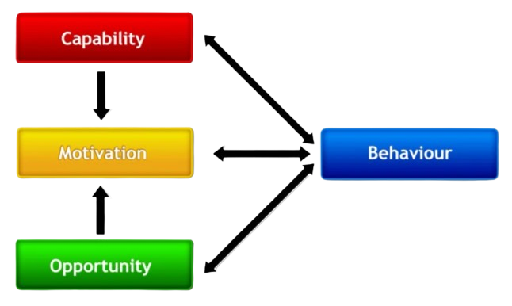
The COM-B Model
Overview: The COM-B model (Capability–Opportunity–Motivation–Behaviour) is a foundational behaviour-change framework, that proposes Behaviour occurs when an individual has: Capability – The psychological and physical capacity to perform the behaviour. Opportunity – External physical and social factors that make the behaviour possible or prompt it. Motivation – Brain processes that energise and direct behaviour, including automatic and reflective processes. (Michie et al 2011)
(Michie et al, 2011)
The model has show efficacy for promoting behaviour change in both diabetes and weight management (Murphy et al 2023; Timkova, et al 2024). While showing acceptability, reliability, and validity as a measure of capabilities, opportunities and motivations (Keyworth et al 2020)
Considerations: the model is not without criticism. With some academics stating the model offers very broad categories that may oversimplify determinants of behaviour (Presseau, et al 2022) and Michie & West themselves noting that the model is designed as a high-level model and requires additional frameworks to be actionable (Michie et al 2011)

Slide 17
Identifying What Needs to Change (1)
COM-B Component | What needs to happen for the behaviour to occur? | Likelihood of changing behaviour Dan rated himself using COM-B Questionnaire, on a scale of 1-10; one being 'Strongly Disagree', ten being 'Strongly agree' for each COM-B Component.
Physical Opportunity | The Environment provides the opportunity to engage in the activity concerned. (e.g. sufficient time, the necessary materials, reminders) | I have the PHYSICAL opportunity to change my fibre intake to improve my health: Dan scored himself 9/10. Physical Opportunity is high-No need for change.
Social Opportunity | Interpersonal Influences, social cues and cultural norms provide the opportunity to engage in the activity concerned. (e.g., support from friends and family) | I have the SOCIAL opportunity to change my fibre intake to improve my health: Dan scored himself 8/10. Social Opportunity is high-No need for change

Slide 18
Identifying What Needs to Change (2)
COM-B Component | What needs to happen for the behaviour to occur? | Is there a need for change with Dan?
Reflective Motivation | Conscious Planning and Evaluations (beliefs about what is good and bad) (e.g. I have desire to/l feel the need to) | I am motivated to change my fibre intake to improve my health. Dan scored himself 8/10. Reflective Motivation is high-No need for change.
Automatic Motivation | Involves doing something without thinking or having to consciously remember (e.g. 'is something I do before I realise I'm doing it') | Changing my fibre intake to improve my health is something that I do automatically. Dan scored himself 5/10. Automative Motivation is lower - need for change.

Slide 19
Identifying What Needs to Change (3)
COM-B Component | What needs to happen for the behaviour to occur? | Is there a need for change with Dan?
Physical Capability | Having the physical skill, strength or stamins to engage in my health (e.g. I have sufficient physical stamina, I can overcome disability, I have sufficient physical skill) | I am physically able to change my fibre intake to improve my health. Dan scored himself 9/10. Physical Capability is high-No need for change.
Psychological Capability | Knowledge and/or psychological skills, strength or stamina to engage in the necessary thought processes for the activity concerned. (e.g. having the knowledge, cognitive and interpersonal skills, having the ability to engage in appropriate memory, attention and decision- making processes). | I am PSYCHOLOGICALLY able to change my fibre intake to improve my health. Dan scored himself 9/10. Psychological Capability is high-No need for change.
What’s need to change to support the target behaviour?
Automatic Motivation.

Slide 20
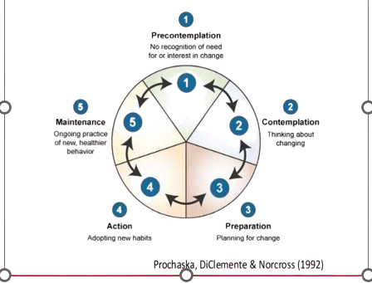
Applying the Transtheoretical Model (TTM)
Overview: The Transtheoretical Model (TTM), also known as the Stages of Change model, is a widely used framework for understanding intentional behaviour change.
It consists of four components:
1) Stages of Change
2) Decisional Balance
3) Self-efficacy
4) Processes of Change.
The model has show efficacy for improving physical activity in adults (Oba et al 2024). As well as behaviours spanning, diet, smoking and other addictions (Prochaska & Velicer 1997).
Considerations: TTM assumes that people progress through stages in order, but real-world behaviour change is often non-linear, rapid, or inconsistent (Littell & Girvin 2002). While a 2003 paper on smoking cessation found that stage-based interventions rarely outperform non–stage-based interventions (Cahill et al 2010).
Prochaska, DiClemente & Norcross (1992)

Slide 21
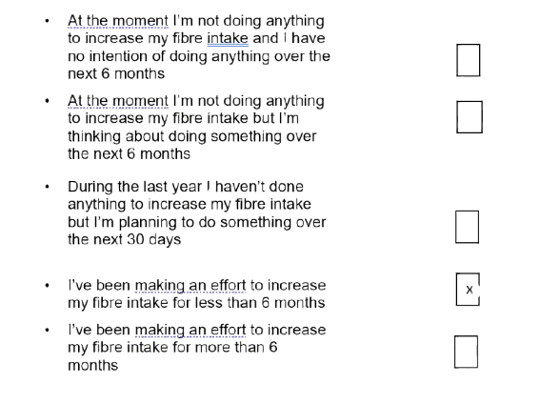
Stages of Change
Dan has completed a stage of change questionnaire:
Outcome: This would suggest Dan is in the Action Stage of Change

Slide 22
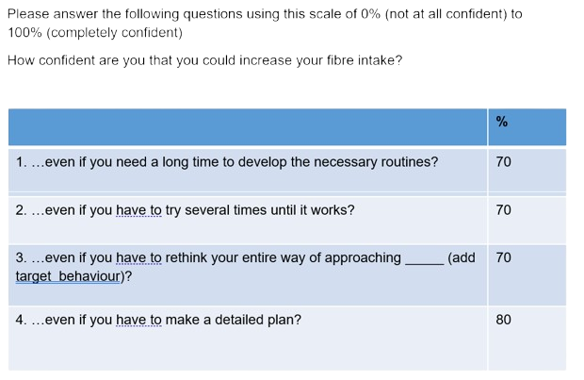
Self-Efficacy
Dan has completed a Self-Efficacy questionnaire:
Outcome: This would suggest Dan’s Self-Efficacy is quite high
Please answer the following questions using this scale of 0% (not at all confident) to 100% (completely confident)
How confident are you that you could increase your fibre intake?

Slide 23
Decisional Balance

Slide 24
References
Michie, S., van Stralen, M. M., & West, R. (2011). The behaviour change wheel: A new method for characterising and designing behaviour change interventions. Implementation Science : IS, 6(1), Article 42. https://doi.org/10.1186/1748-5908-6-42
Presseau, J., Byrne-Davis, L. M. T., Hotham, S., Lorencatto, F., Potthoff, S., Atkinson, L., Bull, E. R., Dima, A. L., van Dongen, A., French, D., Hankonen, N., Hart, J., ten Hoor, G. A., Hudson, K., Kwasnicka, D., van Lieshout, S., McSharry, J., Olander, E. K., Powell, R., … Byrne, M. (2022). Enhancing the translation of health behaviour change research into practice: a selective conceptual review of the synergy between implementation science and health psychology. Health Psychology Review, 16(1), 22–49. https://doi.org/10.1080/17437199.2020.1866638
Littell, J. H., & Girvin, H. (2002). Stages of Change: A Critique. Behavior Modification, 26(2), 223–273. https://doi.org/10.1177/0145445502026002006
Cahill, K., Lancaster, T., & Green, N. (2010). Stage‐based interventions for smoking cessation. Cochrane Database of Systematic Reviews, 2010(11), CD004492. https://doi.org/10.1002/14651858.CD004492.pub4
Oba, T., Takano, K., Katahira, K., & Kimura, K. (2024). Revisiting the Transtheoretical Model for Physical Activity: A Large-Scale Cross-Sectional Study on Japanese-Speaking Adults. Annals of Behavioral Medicine, 58(3), 167–178. https://doi.org/10.1093/abm/kaad069
Prochaska, J. O., & Velicer, W. F. (1997). The Transtheoretical Model of Health Behavior Change. American Journal of Health Promotion, 12(1), 38–48. https://doi.org/10.4278/0890-1171-12.1.38
Murphy, K., Berk, J., Muhwava-Mbabala, L., Booley, S., Harbron, J., Ware, L., Norris, S., Zarowsky, C., Lambert, E. V., & Levitt, N. S. (2023). Using the COM-B model and Behaviour Change Wheel to develop a theory and evidence-based intervention for women with gestational diabetes (IINDIAGO). BMC Public Health, 23(1), Article 894. https://doi.org/10.1186/s12889-023-15586-y
Timkova, V., Minarikova, D., Fabryova, L., Buckova, J., Minarik, P., Katreniakova, Z., & Nagyova, I. (2024). Facilitators and barriers to behavior change in overweight and obesity management using the COM-B model. Frontiers in Psychology, 15, 1280071. https://doi.org/10.3389/fpsyg.2024.1280071
Keyworth, C., Epton, T., Goldthorpe, J., Calam, R., & Armitage, C. J. (2020). Acceptability, reliability, and validity of a brief measure of capabilities, opportunities, and motivations (“COM‐B”). British Journal of Health Psychology, 25(3), 474–501. https://doi.org/10.1111/bjhp.12417

